Slide 1
Computer Networks

Slide 2
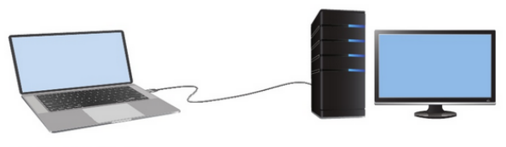
What is a Computer Network?
A network is a collection of two or more devices that are connected together to share resources, exchange data, and communicate with each other.

Slide 3
Host / End Device?
All devices that are connected to a network and participate directly in network communication are classified as hosts.
Hosts are also called end devices.
Example: Computers, Servers, Smartphones, Printers, and etc.

Slide 4
Client?
A client is a type of host that requests services from another device. Clients use software to request and display information received from servers.

Slide 5
Server?
A server is a type of host that provides services to other devices. Servers run software that allows them to provide information and services, often to multiple clients simultaneously.

Slide 6
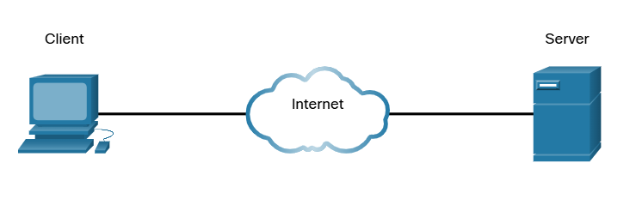

Slide 7
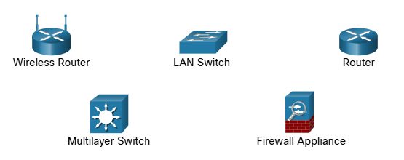
Intermediary Devices
Network devices that connect hosts and help manage the flow of data across the network.
They do not generate or consume data like end devices, but instead forward, direct, and control data traffic between devices.

Slide 8
Intermediary Devices
Forward data to the correct destination
Determine the best path for data to travel
Filter and secure traffic (Ex: firewalls)
Connect different networks together

Slide 9
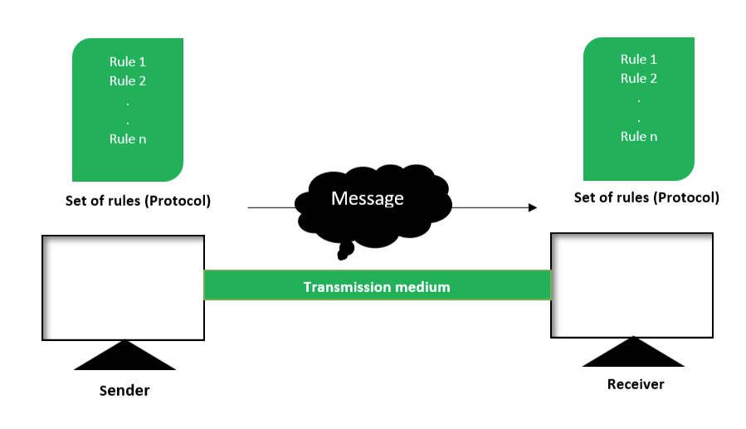
Components of Data Communication System

Slide 10
1. Sender
The device that initiates (sends) the data.

Slide 11
2. Receiver
The device that receives the data.

Slide 12
Question:
Is the client always the sender and the server always the receiver?

Slide 13
Answer:
No
A client and a server can both act as sender or receiver depending on the direction of communication. For example, when a client request data, it is the sender and the server is the receiver. When the server sends the requested data back, the server becomes the sender and the client becomes the receiver.

Slide 14
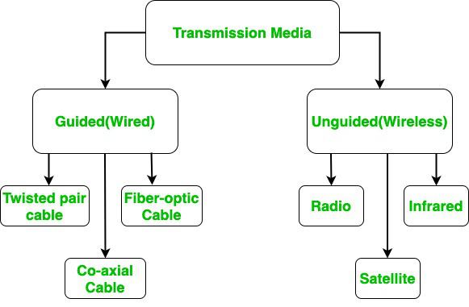
3. Transmission Media
Transmission media refer to the physical pathways through which data is transmitted from one device to another within a network.

Slide 15
Guided Media (Wired)
Data travels through a physical path such as cables.

Slide 16
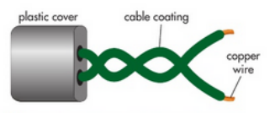
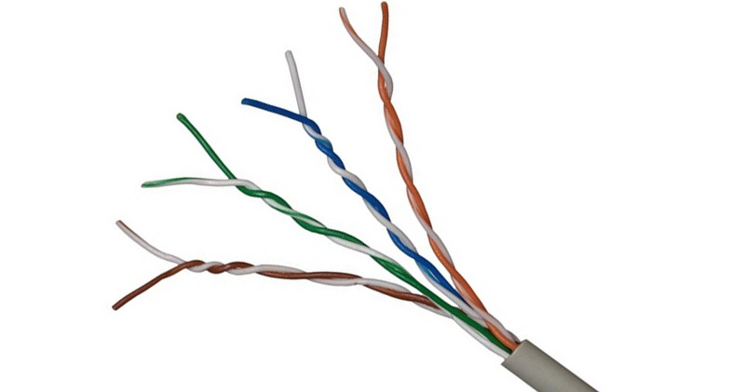
Twisted pair cable
A twisted pair cable is a type of copper cable that has two copper wires. Each copper wire has an insulated layer. The two copper wires are twisted around each other, and there is an outer plastic layer covering them.
Characteristics of twisted pair cables.
They transmit data using electrical currents.
They can transmit data up to a speed of 10 Gbps.
They are cheap to manufacture.
They can suffer from electromagnetic interference, so are only used to carry data over short distances.
They are easy to install.
They are mainly used for telephone communications and for Ethernet connections in a local area network within one building.

Slide 17
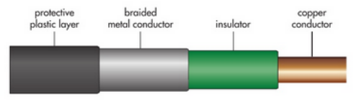
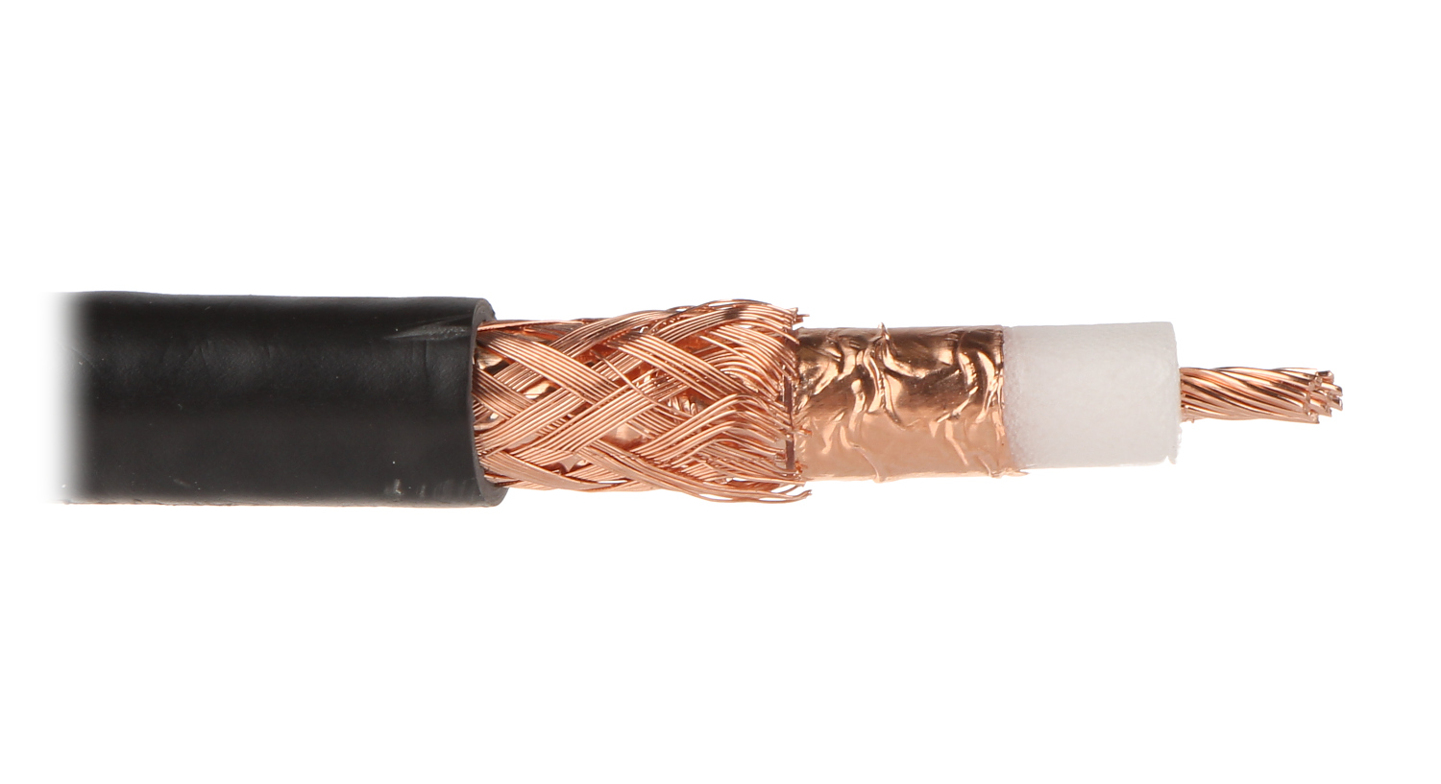
Coaxial cable
A coaxial cable is a type of copper cable. It has a central copper wire that has an insulated layer, a metal conductor layer and a protective plastic outer layer.
Characteristics of coaxial cables.
They transmit data using radio frequency signals.
They can transmit data at speeds of up to 10 Mbps.
They are cheap to manufacture, but not as cheap as twisted pair cables.
They are less prone to electromagnetic interference because of the braided metal conductor layer.
They are difficult to install, as they can be stiff and difficult to bend.
They are mainly used in cable TV connections and sometimes in internet connections.

Slide 18
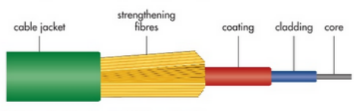
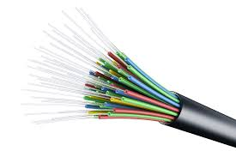
Fiber optic cable
A fiber optic cable has many very thin strands of glass or plastic that make up the core of the cable. The core is covered by a cladding, which is covered by a plastic coating. This plastic coating is covered by strengthening fibers and then an outer coating.
Characteristics of fiber optic cables.
They transmit data using light.
They can transmit data up to speeds of 1 Gbps.
They are expensive to manufacture.
They are not prone to electromagnetic interference.
They are difficult to install, as the cables can be fragile.
They are often used for internet connection and transmitting data over long distances.

Slide 19
Unguided Media (Wireless)
Data travels through the air (no physical connection) using electromagnetic waves.

Slide 20
Microwaves
A twisted pair cable is a type of copper cable that has two copper wires. Each copper wire has an insulated layer. The two copper wires are twisted around each other, and there is an outer plastic layer covering them.
Characteristics of twisted pair cables.
They transmit data using electrical currents.
They can transmit data up to a speed of 10 Gbps.
They are cheap to manufacture.
They can suffer from electromagnetic interference, so are only used to carry data over short distances.
They are easy to install.
They are mainly used for telephone communications and for Ethernet connections in a local area network within one building.

Slide 21
Radio waves
A twisted pair cable is a type of copper cable that has two copper wires. Each copper wire has an insulated layer. The two copper wires are twisted around each other, and there is an outer plastic layer covering them.
Characteristics of twisted pair cables.
They transmit data using electrical currents.
They can transmit data up to a speed of 10 Gbps.
They are cheap to manufacture.
They can suffer from electromagnetic interference, so are only used to carry data over short distances.
They are easy to install.
They are mainly used for telephone communications and for Ethernet connections in a local area network within one building.

Slide 22
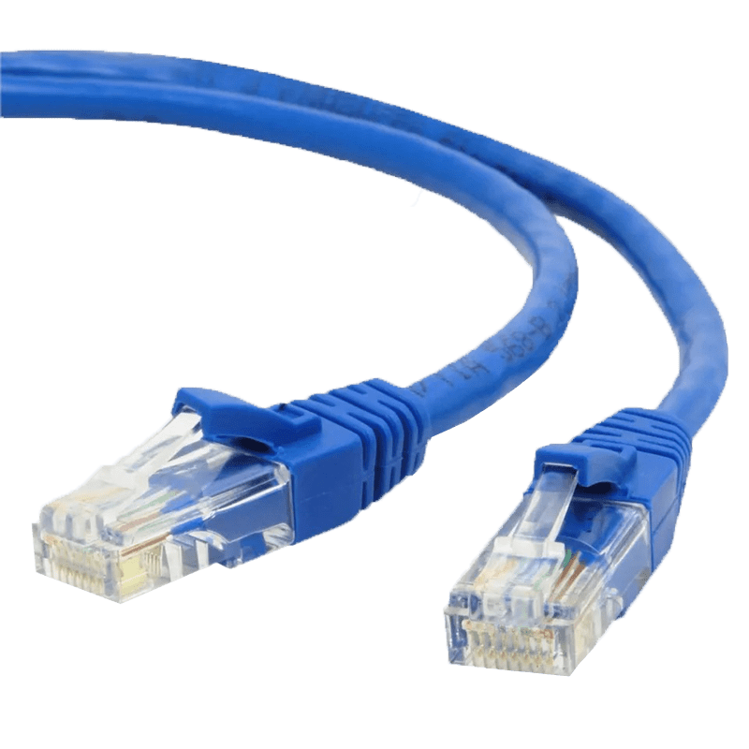
Ethernet
Ethernet is a wired networking technology used to connect computers, printers, routers, and other devices in a local area network (LAN). It (Ethernet protocol) defines how data is formatted, transmitted, and received over physical cables like Cat5e, Cat6, or fiber optic..
Ethernet cables can be coaxial, twisted pair or fiber optic.
LAN – Network that is located within a single building or site

Slide 23
Question
What is NIC?

Slide 24
NIC?
NIC (Network Interface Card) is the hardware component that allows a device to connect to a network.
It acts as an interface between the device and the network, enabling the device to send and receive data.
NIC can be wired (Ethernet) or wireless (WNIC).
Modern computers usually have NICs built into the motherboard, Can add one if needed.
Every NIC has a unique identifier (MAC Address).

Slide 25
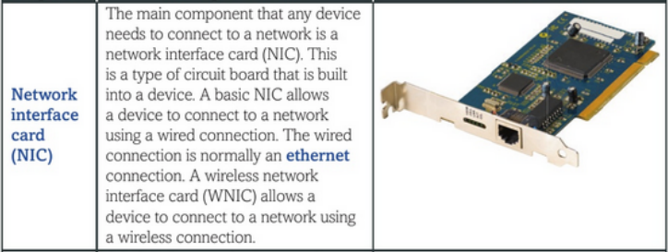
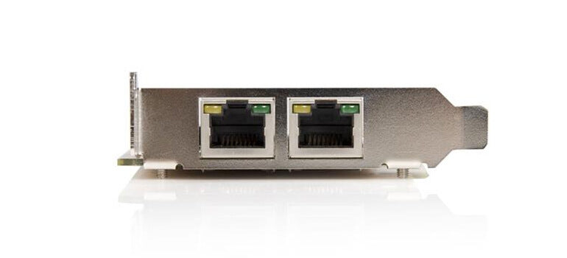

Slide 26
Question
Since MAC addresses must be globally unique, how do different vendors coordinate to make sure the same address is not assigned more than once?

Slide 27
Answer
Vendors don’t randomly generate MAC addresses. They are assigned in a structured way by a central authority called the IEEE.

Slide 28
How MAC addresses stay unique
A MAC address is 48 bits (like: 00:1A:2B:XX:XX:XX) and is divided into two parts:
1. OUI (Organizationally Unique Identifier) – first 24 bits
This part is assigned by IEEE.
Each vendor (like Intel, Cisco, Apple) buys/registers an OUI block. Example:00:1A:2B → belongs to one specific company
This means:No two vendors will have the same prefix
IEEE keeps a global registry of all assigned OUIs
2. Device-specific part – last 24 bits
This part is generated by the vendor
The vendor ensures no duplicates within their own devices

Slide 29
MAC Address
A MAC address can be used to identify a device in a network. The MAC address is assigned by the manufacturer of the device when it is being made. The MAC address is given to the NIC that is built into the device
Features of a MAC address:
Each address is unique.
It is written in hexadecimal.
It has 12 digits and the digits are grouped in pairs.
Each pair of digits is separated by a colon.
The first three pairs of digits are the manufacturer's ID.
The second three pairs are the serial number of the device.
Example - 3C:5A:B4:01:63:D2

Slide 30
4. Message
The actual data or information that is being communicated between the sender and the receiver. It can be in a text, images, audio, video files, depending on the type of communication.

Slide 31
Question
How data like text, images, or videos are send over a network?

Slide 32
Answer
All types of data whether text, images, audio, or video are represented and stored as binary (1s and 0s) inside a computer. When this data is transmitted over a network, the binary bits are encoded into physical signals. In wired networks, they travel as electrical or light signals, and in wireless networks, they travel as radio waves. Every message we send is a stream of binary data transmitted as signals.
Cables: Data is encoded into electrical impulses.
Fiber-Optic: Data is encoded into pulses of light.
Wireless transmission: Data is encoded via modulation of specific frequencies of electromagnetic waves.

Slide 33
Bandwidth
Bandwidth is the maximum capacity of a channel.
Maximum amount of data that can be transmitted per second.

Slide 34
Throughput
Bandwidth is the maximum capacity of a channel.
Maximum amount of data that can be transmitted per second.

Slide 35
Question
Why Throughput < Bandwidth?

Slide 36
Answer
In real networks, we never achieve full bandwidth due to:
Network congestion (too many devices)
Packet loss & retransmissions
Protocol overhead (headers, control data)
Delays and interference
Actual data transfer (throughput) is always less than theoretical maximum (bandwidth).

Slide 37
Question
In wireless networks, throughput is much lower. Why?

Slide 38
Answer
Throughput in wireless networks is lower because multiple devices share the same medium, and signals are affected by interference, distance, and obstacles. This leads to errors and retransmissions, reducing the actual data transfer rate.

Slide 39
5. Protocol
Set of rules both sender and receiver must follow to ensure successful communication.

Slide 40
Question
Explain HTTP protocol?

Slide 41
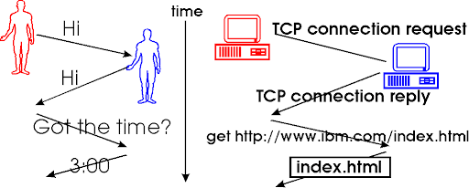
Answer
when your browser (the sender) sends a request to a website (the receiver) using HTTP (HyperText Transfer Protocol), the website’s server must also understand and respond using the same protocol. If both ends follow HTTP correctly, the browser can successfully load the webpage. If not, the communication will fail.
It’s just like two people speaking different languages without understanding each other.

Slide 42
Rules or Main aspects in HTTP
Request and Response format: Every communication in HTTP follows a specific format.
A request from the client includes a method.
GET: Retrieves data from the server.
POST: Sends data to the server, often to create or update resources.
PUT: Replaces a resource on the server with the data sent in the request.
DELETE: Deletes a resource on the server.
These methods guide what client wants and how the server should respond. So the client makes a “GET” request means,
It is asking the server to send back some data — As an example when you type a URL in your browser and press Enter, the browser sends a GET request to the server to fetch that page. Server process it and responds with the requested data, like an HTML file, and your browser displays it.
2. Status Codes
When the server responds, it includes a status code to indicate the result of the request. Examples include:
200 OK: The request was successful
404 Not Found: The requested resource doesn’t exist
500 Internal Server Error: A problem occurred on the server
These codes help the browser or client app understand what happened.

Slide 43
3. Headers
Headers provide extra information about the request or response, such as:
Content-Type: Tells what kind of data is being sent (e.g., HTML, JSON)
User-Agent: Identifies the browser
Authorization: Contains login credentials or tokens
Headers are key-value pairs that add context to the communication.
4. Statelessness
Also HTTP is stateless, meaning each request is treated independently. The server does not remember anything about previous requests from the same client.
Like HTTP we have other protocols.
FTP (File Transfer Protocol) - Used for transferring files between a client and server.
SMTP (Simple Mail Transfer Protocol) - Used for sending emails from a client to a mail server.

Slide 44
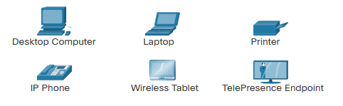
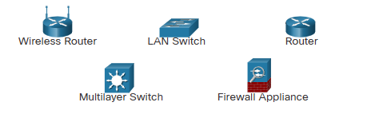
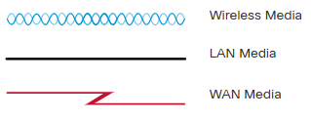
Network Infrastructure
The network infrastructure contains three categories of hardware components.
End devices
Intermediate devices
Network media

Slide 45
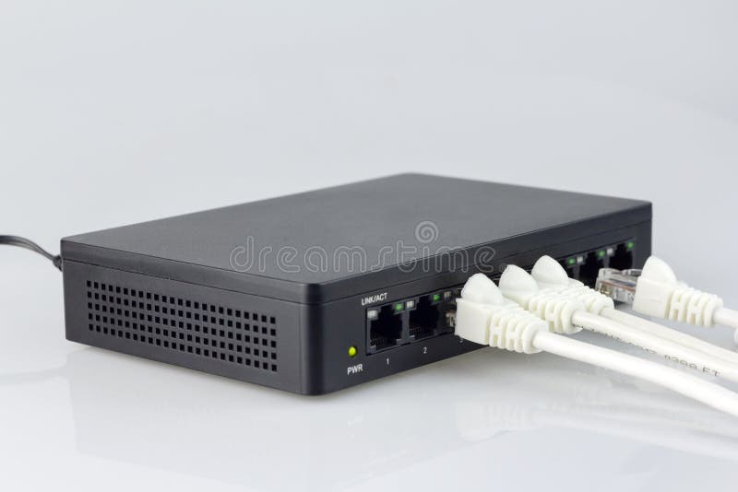
Hub
A hub is the most basic way of connecting several devices in a local area network (LAN).
A hub receives data packets and forwards them on to all devices that are connected to the hub. Only the intended destination device will accept the data sent; the other devices connected to the hub will just ignore it.
Each device is connected to a hub using a wired connection.
The type of wired connection normally used for a hub is either an ethernet connection or a USB connection.
There is a lot of unnecessary traffic in a network where hubs are used. This can cause a lot of data collisions, which can cause errors to occur and reduce the performance of the network.

Slide 46
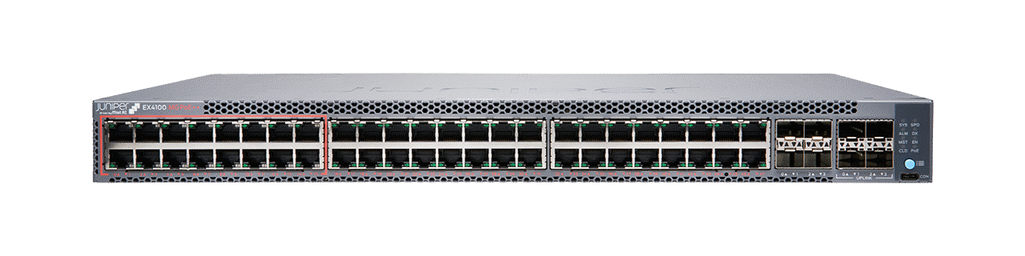
Switch
A switch was developed as an improvement to the inefficiency of a hub. A switch is also used to connect several devices in a LAN network.
Switch, only sends the data packets to the intended destination. It does this by using a device's media access control (MAC) address.
A switch records all the MAC addresses of devices that are attached to it and stores them in a table. It looks at the data packet to find the destination MAC address and forwards the data packet on to this device only.
This reduces the amount of traffic in the network and as a result reduces the number of data collisions. This improves the performance of the network.

Slide 47
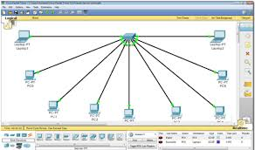
Activity: Install Packet Tracer

Slide 48
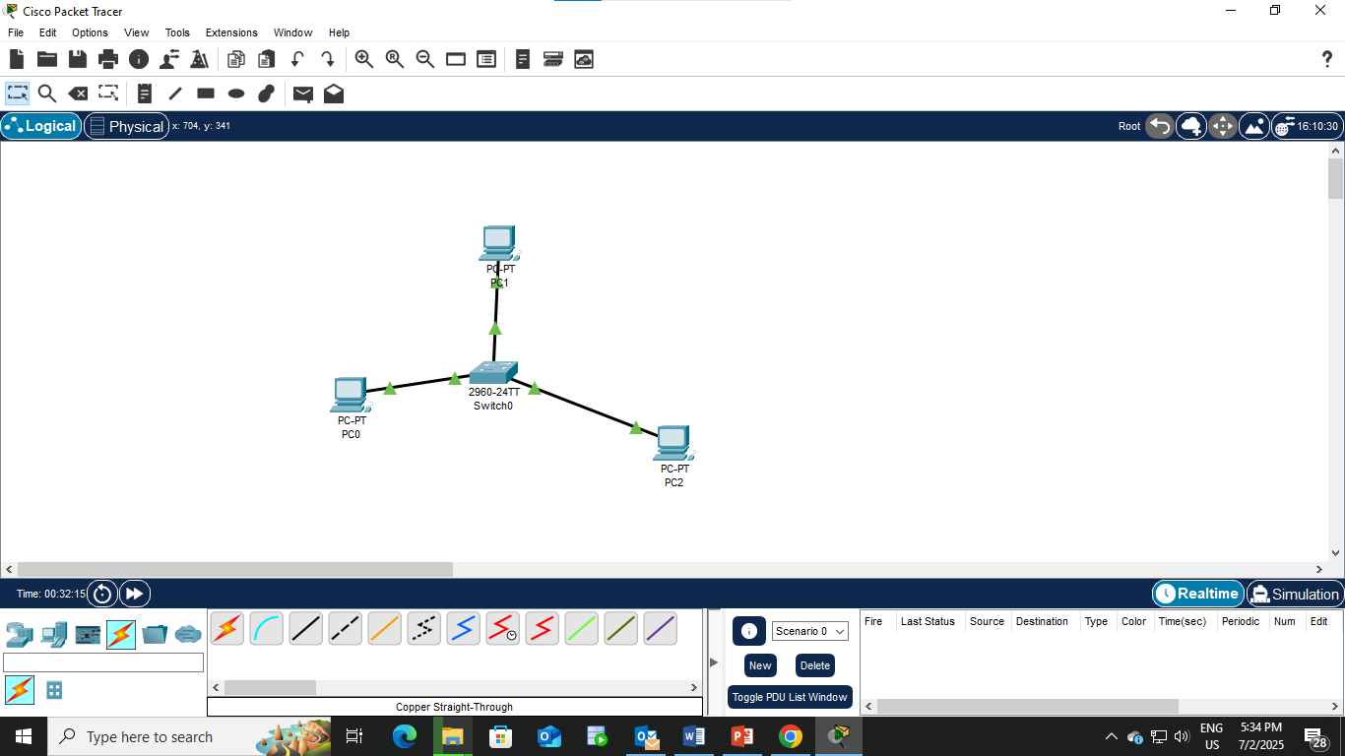
Activity: Transfer a data packet between two PCs

Slide 49
IP Address
An IP address (Internet Protocol Address) is a unique numerical identifier assigned to each device connected to a network that uses the Internet Protocol for communication.
IP address is use to uniquely identify a device on the network and to determine where the device is located in the network, so data can be sent to and from it.
IPV4 – 192.168.1.1
IPV6 - 2001:0db8:85a3:0000:0000:8a2e:0370:7334
The sender includes the destination IP address in the data packet. Routers use this IP address to forward the packet to the correct destination.

Slide 50
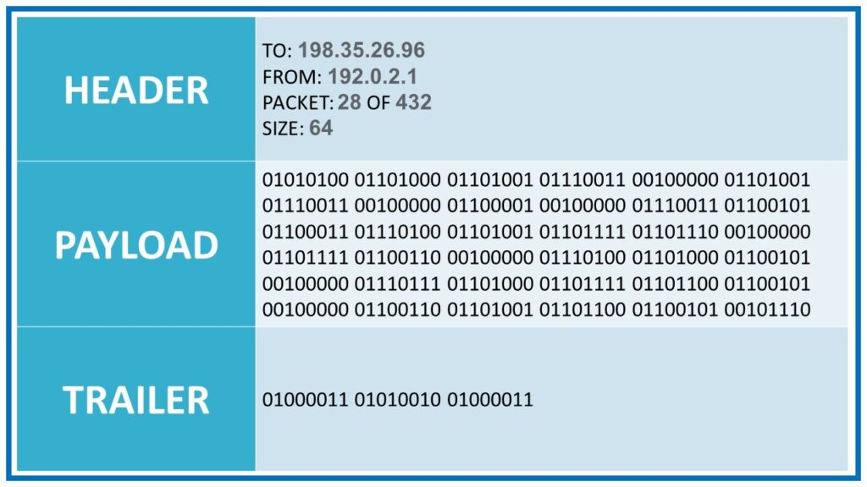
Data Packet
The unit of data that contains the information to be transmitted across a network

Slide 51
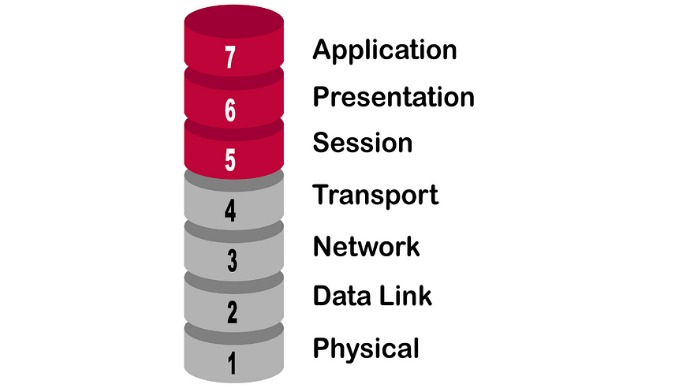
OSI Model
A universal standard for communication. It allowed different hardware and software systems to talk to each other.

